Slide 1

Transfer Learning-Driven Deep Model for Alzheimer’s Prediction
GUIDE: Dr.Blessy Queen Mary M
Team Members:
Guruswathi B - 71772118111
Muthumaha S - 71772118129
Shunmuga Priya R - 71772118140
Tamil Selvi A - 71772118149

Slide 2
Problem Statement:
Alzheimer's disease (AD) is a progressive neurodegenerative disorder that leads to cognitive decline and memory loss.
Early detection and accurate classification of Alzheimer’s stages (Non-Demented, Very Mild Demented, Mild Demented, Moderate Demented) are crucial for effective intervention and treatment.
Traditional diagnostic methods rely heavily on clinical assessments and manual interpretation of MRI scans, which are time-consuming, subjective, and prone to human error.
There is a need for an automated and accurate system to classify the severity of Alzheimer's disease using brain MRI data.

Slide 3
Objective
To develop a deep learning-based automated system for predicting the severity levels of Alzheimer’s disease using MRI images.
To segment MRI brain scans to focus on regions of interest using U-Net architecture, improving feature extraction.
To utilize transfer learning with ResNet-101 for accurate classification into four categories: Non-Demented, Very Mild Demented, Mild Demented, and Moderate Demented.
To achieve high accuracy, precision, and sensitivity in Alzheimer’s stage classification, improving early diagnosis and aiding clinicians in decision-making.

Slide 4
Existing System
Traditional diagnostic approaches for Alzheimer’s include: Neuropsychological assessments, Manual analysis of MRI scans by radiologists or neurologists.
Deep learning methods, including Convolutional Neural Networks (CNNs), have been applied but often lack preprocessing like segmentation or rely on limited data.
Several models only focus on binary classification (Alzheimer’s vs. Non-Alzheimer’s) rather than multi-class severity prediction.

Slide 5
Challenges in Existing System
Manual Diagnosis Limitations:
Time-consuming and prone to human error. Subjective interpretation can lead to inconsistent diagnoses.
Limited Multi-Class Prediction:
Many existing systems focus on detecting the presence of Alzheimer’s but not its severity.
Data Imbalance:
Limited data availability for certain classes like Moderate Demented leads to biased models.
Lower Accuracy & Generalization:
Existing machine learning methods may suffer from overfitting or underfitting, with limited ability to generalize across new datasets.

Slide 6
Proposed System
The system processes MRI brain images through normalization, resizing, and grayscale-to-RGB conversion for model compatibility.
U-Net segmentation isolates critical brain regions to enhance feature focus and improve classification accuracy.
ResNet-101, with transfer learning, extracts deep features and classifies Alzheimer’s stages: Non-Demented, Very Mild, Mild, and Moderate Demented.
The model is trained, validated, and evaluated, achieving 96.06% accuracy in multi-class Alzheimer’s severity prediction.
Enables automated, accurate, and scalable Alzheimer’s stage detection to support early diagnosis and clinical decision-making.

Slide 7



Flow chart
Data
preprocessing
Image segmentation
(U-Net)
Model Selection
(ResNet-101)
Dataset
Prediction/Inference
Model Evaluation (Classification)
Model Training
Model Customization (Transfer learning)

Slide 8
Module Descriptions
1. Data collection and Preprocessing Module
Collect MRI images from the Kaggle Alzheimer’s MRI dataset.
Dataset contains four categories: Non-Demented, Very Mild Demented, Mild Demented, Moderate Demented.
Normalize and standardize MRI images to ensure uniform input.
Resize images to a fixed dimension (128 × 128 pixels).
2. Image Segmentation Module (U-Net)
Segment MRI brain images to highlight key regions of interest.
U-Net architecture separates structures like the hippocampus which are important for detecting Alzheimer’s progression.

Slide 9
3. Feature Extraction & Classification Module (ResNet-101)
Use transfer learning with ResNet-101 to extract features from segmented images.
Fine-tune the model to classify images into four categories based on Alzheimer’s severity.
4. Training and Validation Module
Split the dataset (80% training, 10% testing, 10% validation).
Evaluate model performance using accuracy, precision, recall, F1-score.

Slide 10
5. Prediction/Inference Module
Along with predicting the class label, the model outputs probability scores for each category.
This helps in understanding the confidence level of the prediction, aiding in better clinical decisions.

Slide 11
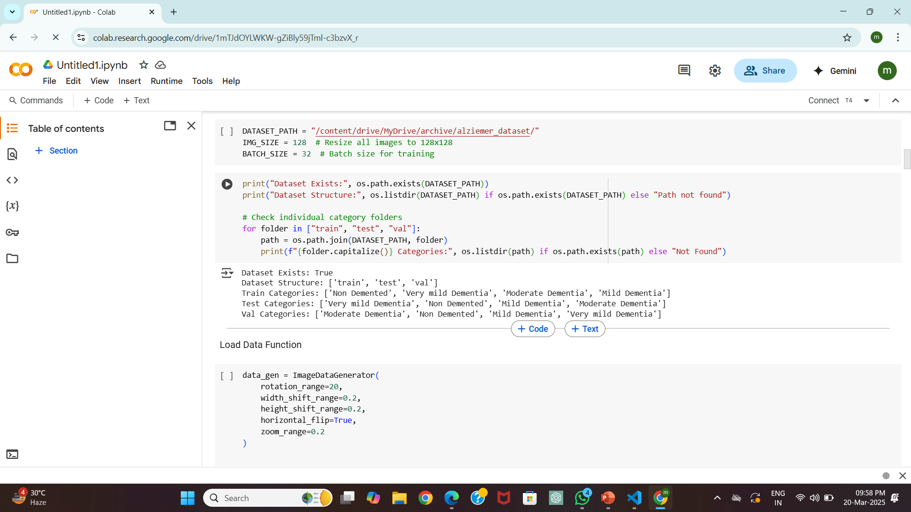
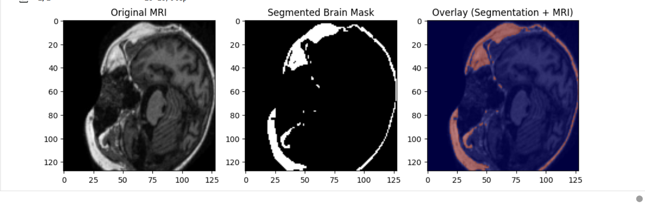
Fig 1.1 CATEGORY SPECIFICATION
Fig 1.2 SEGMENTATION

Slide 12
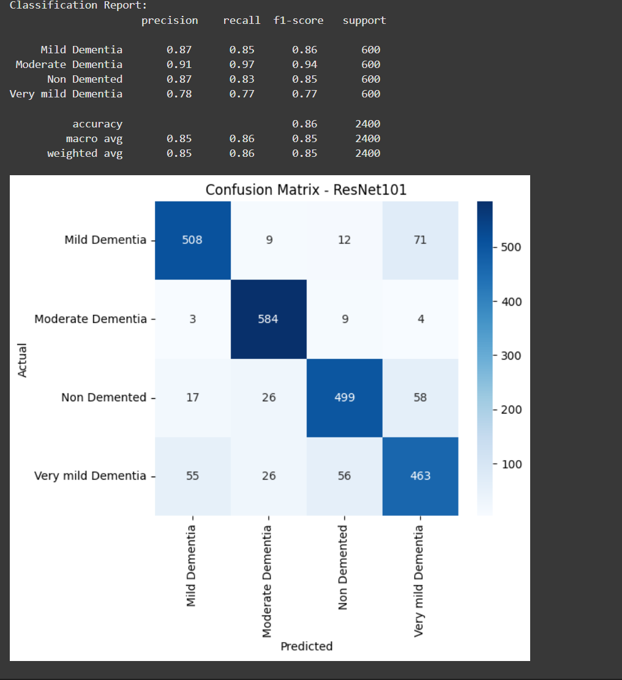
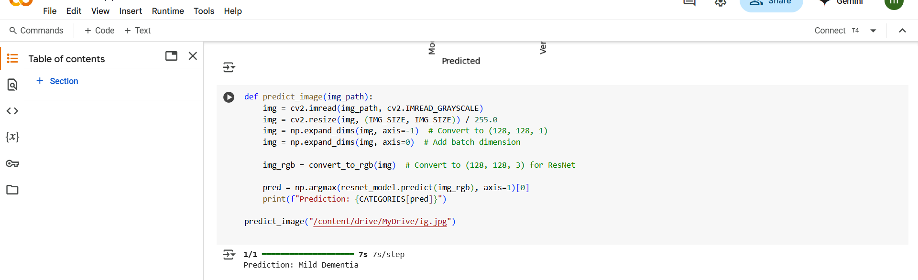
Fig 1.3 CONFUSION MATRIX
Fig 1.4 PREDICTION

Slide 13
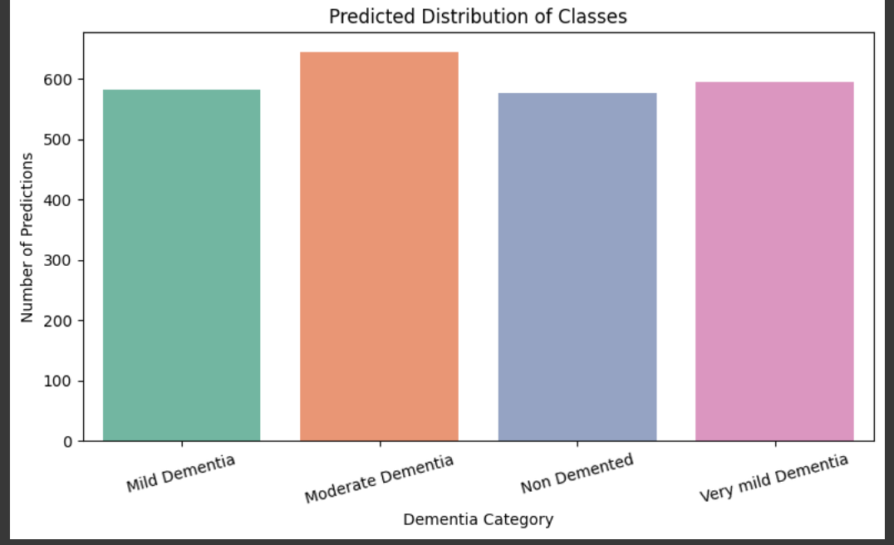
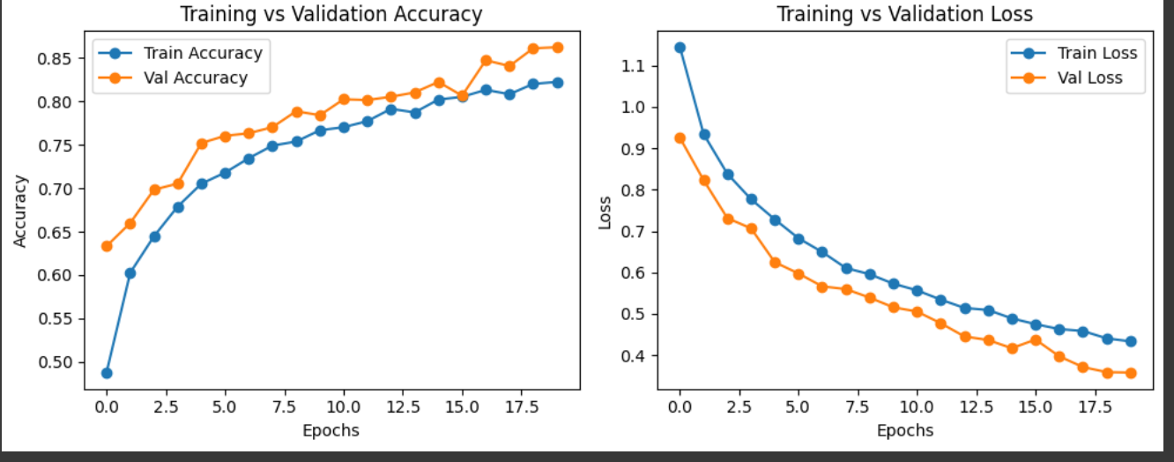
Fig 1.4 PREDICTION PER CATEGORY
Fig 1.5 ACCURACY &LOSS CURVES

Slide 14
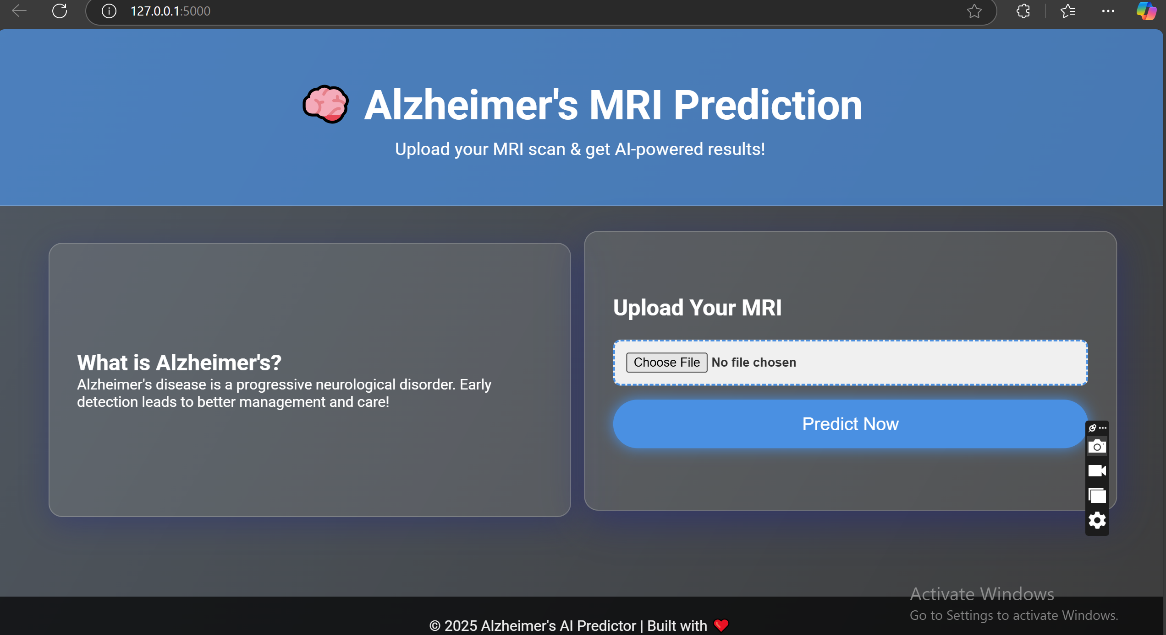
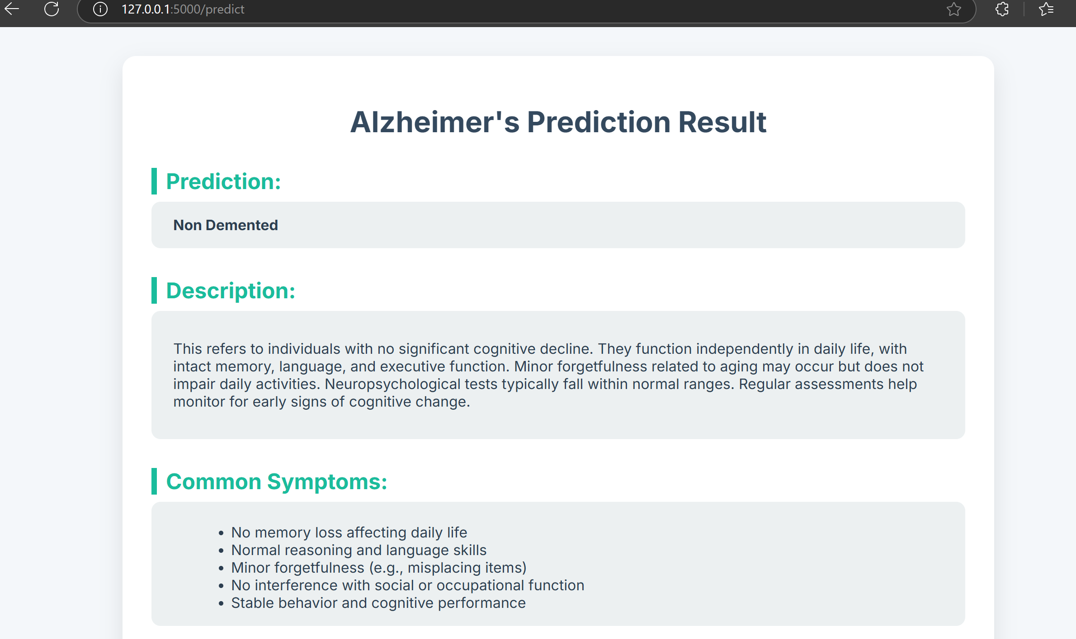
Fig 1.6 WEB INTERFACE
Fig 1.7 PREDICTION RESULT

Slide 15
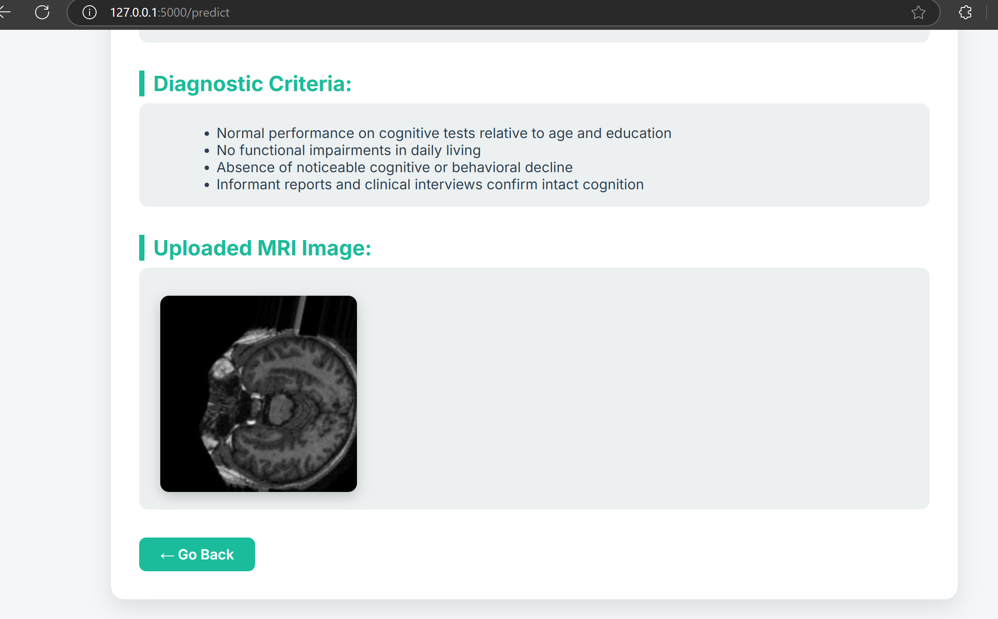
Fig 1.8 PREDICTION RESULT

Slide 16
LITERATURE SURVEY
Title | Author(s) | Year | Algorithm | Merit | Demerit
ML-Powered Handwriting Analysis for Early Detection of Alzheimer’s Disease | Uddalak Mitra, Shafiq Ul Rehman | 2024 | Ensemble ML with stacking technique | High accuracy (97.14%), non-invasive handwriting analysis | Computational complexity, dataset dependency​
Volumetric Feature-Based Alzheimer’s Disease Diagnosis From sMRI Data Using a CNN and a DNN | Abol Basher, Byeong C. Kim, Kun Ho Lee, Ho Yub Jung | 2021 | CNN + DNN on sMRI | High classification accuracy (94.82%), effective hippocampus analysis | Requires MRI data, computationally expensive​
Cognitive Decline Detection for Alzheimer’s Disease Patients Through an Activity of Daily Living (ADL) | G. Palacios-Navarro, J. Buele, S. Gimeno Jarque, A. Bronchal García | 2022 | ADL-based task evaluation | Ecological validity, real-life cognitive assessment | Limited sample size, potential bias​
Alzheimer’s Disease Diagnosis in the Preclinical Stage: Normal Aging or Dementia | Fahimeh Marvi, Yun-Hsuan Chen, Mohamad Sawan | 2025 | Biosensors and neuroimaging techniques | Early detection through biosensors, non-invasive | Lack of commercialization, data reproducibility issues​

Slide 17
LITERATURE SURVEY
Title | Author(s) | Year | Algorithm | Merit | Demerit
A Binary Classification Study of Alzheimer’s Disease Based on a Novel Subclass Weighted Logistic Regression Method | Jinhua Sheng, Shuai Wu, Qiao Zhang, Zhongjin Li, He Huang | 2022 | Subclass Weighted Logistic Regression (SWLR) | High accuracy (95.8%), interpretable model | Complexity in subclass weighting, dataset dependency​
Total Body 100-mGy X-irradiation Does Not Induce Alzheimer’s Disease-Like Pathogenesis or Memory Impairment in Mice | Bing Wang, Kaoru Tanaka, Bin Ji, et al. | 2013 | X-ray exposure analysis | No significant AD-like effects from radiation exposure | Limited to animal models, not applicable to humans​
Integrating Pause Information with Word Embeddings in Language Models for Alzheimer’s Disease Detection from Spontaneous Speech | Yu Pu, Wei-Qiang Zhang | 2025 | Transformer-based NLP model with speech pauses | Effective in detecting AD from speech (83.1% accuracy) | Dependent on speech datasets, ASR accuracy limitations​
Longitudinal Alzheimer’s Disease Progression Prediction With Modality Uncertainty and Optimization of Information Flow | Duy-Phuong Dao, Hyung-Jeong Yang, Jahae Kim, Ngoc-Huynh Ho | 2025 | Multimodal Deep Learning (LMDP-Net) | Handles missing data, improves disease progression prediction | Increased complexity

Slide 18
Conclusion
The proposed deep learning model effectively classifies Alzheimer’s disease severity using MRI images.
By incorporating U-Net for segmentation and ResNet-101 for classification, the system achieves high accuracy and reliability.
Segmentation allows for focusing on critical brain regions, improving classification performance.
The model provides an automated, efficient, and accurate method for early detection and staging of Alzheimer’s disease.
Future work includes expanding the dataset, improving class balance, and integrating explainability techniques (e.g., Grad-CAM) to enhance the interpretability of predictions.

Slide 19
REFERENCES:
1. Longitudinal Alzheimer’s Disease Progression Prediction With Modality Uncertainty and Optimization of Information Flow https://ieeexplore.ieee.org/document/10702601 2. Integrating Pause Information with Word Embeddings in Language Models for Alzheimer’s Disease Detection from Spontaneous Speech https://ieeexplore.ieee.org/document/10888563
3. Total Body 100-mGy X-irradiation Does Not Induce Alzheimer’s Disease-Like Pathogenesis or Memory Impairment in Mice https://ieeexplore.ieee.org/document/9809963/ 4. Binary Classification Study of Alzheimer’s Disease Based on a Novel Subclass Weighted Logistic Regression Method https://ieeexplore.ieee.org/document/9809963/

Slide 20
5. Alzheimer’s Disease Diagnosis in the Preclinical Stage: Normal Aging or Dementia https://ieeexplore.ieee.org/document/10472088/
6. Cognitive Decline Detection for Alzheimer’s Disease Patients Through an Activity of Daily Living (ADL)
https://ieeexplore.ieee.org/document/9849698/ 7. Volumetric Feature-Based Alzheimer’s Disease Diagnosis From sMRI Data Using a CNN and a DNN
https://ieeexplore.ieee.org/document/9354805/ 8. ML-Powered Handwriting Analysis for Early Detection of Alzheimer’s Disease https://ieeexplore.ieee.org/document/10530648

